Slide 1
Oral Literature Presentation
“Study Studio”
Elishua Brown
Ahmed Kamara
Michael Lentzis
Kimberly Matthews
Jonathan Nieves

Slide 2
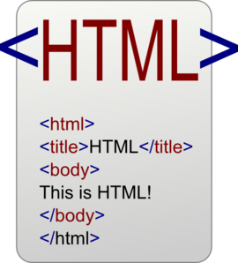

It’s a Website
HTML- Hypertext Markup Language, a standardized system for tagging text files to achieve font, color, graphic, and hyperlink effects on World Wide Web pages.
CSS- the language for describing the presentation of Web pages, including colors, layout, and fonts. Independant from HTML and will allow adaptation to different devices. (Mobile Applications, etc.)
HTTPS is a protocol for secure communication over a computer network which is widely used on the Internet. Used to secure the network.
JavaScript- Common uses are image manipulation, form validation, and dynamic changes of content.

Slide 3
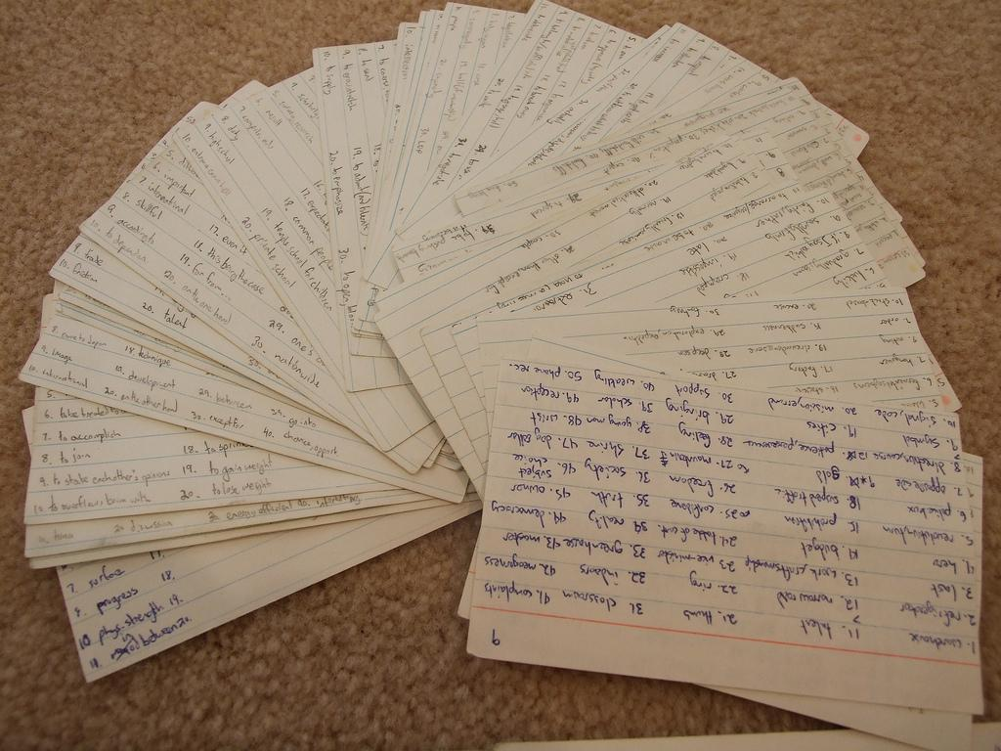
Flash Card Design
Intro
Studying has always been a way people see fit to measure one’s knowledge of a task or subject.
The system of standardized testing has become an important factor for jobs and schools.
There have been hundreds of studies that have proven that spaced repetition is a powerful tool for memorizing information.
“Study Studio” is based off a flashcard study design for this precise fact but will have additional features that will make it the best studying tool.

Slide 4
Flash Cards
Teaching
First of all, students have to be taught the material in order to be tested on it.
“Study Studio” will allow teachers to do this with ease through use of flashcard design implemented through a mix of Java, CSS, and HTML.
Online Vs. Classroom
Always Available
Teachers can Create and share cards with students
Students can create their own cards easily.
Difficult to study topics while learning.
It is harder to admit wrong answers
Class time is limited

Slide 5
Flash Cards
Students
“Study Studio” will be based on a flashcard study approach in order to enhance user experience in studying techniques.
The goal of this website is to help users reach their desired level of knowledge while adding extra factors such as creating their own cards and adding voice to the cards.
These features will also be made available through HTML and Javascript applications.

Slide 6
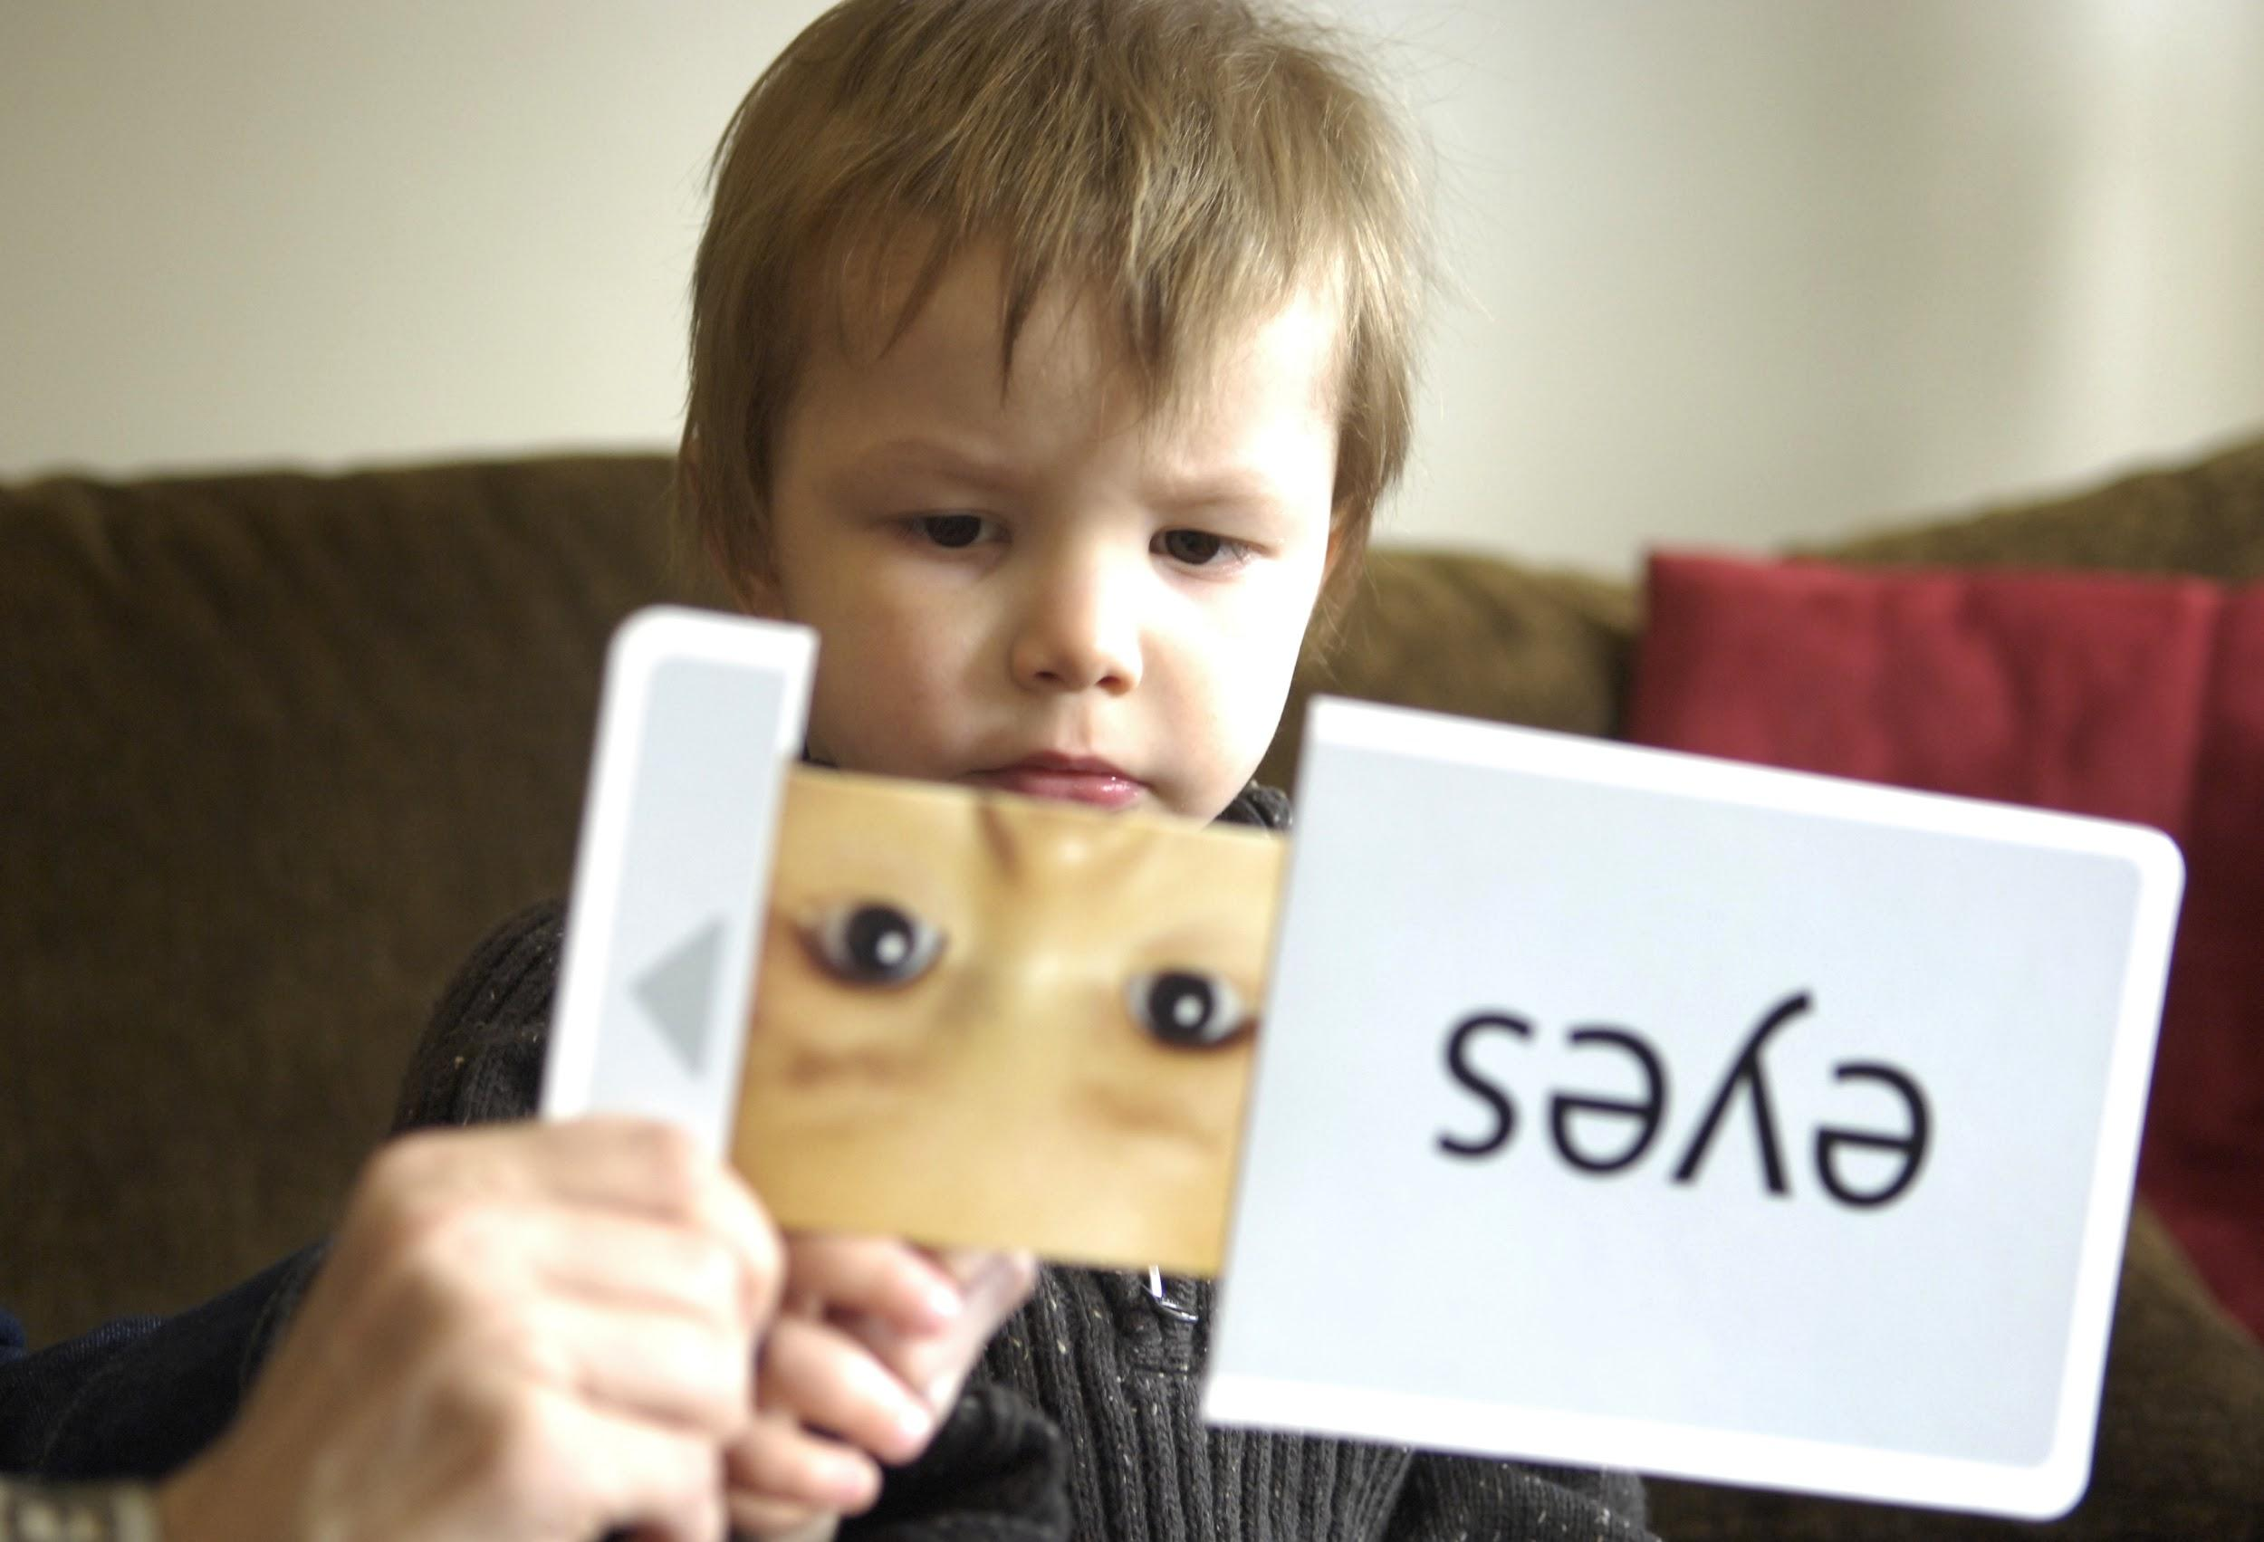
Flash Cards
Flashcards are highly effective for a few reasons
When an individual looks at one side and tries to remember the answer, a mental process called “active recall” is activated.
Flashcards force active recall and the individual obtains stronger neuron connections for that area in memory.
When the answer is compared with their own, it is called metacognition, which is the process that ingrains memories in the mind.
Lastly, arrangement builds confidence in knowledge of a subject.

Slide 7
Flash Cards!!!
Our site will allow freedom of creation and editing of cards to help users gain confidence in what they study,
By incorporating methods that facilitate repetition, our site will consciously and subconsciously make studying and teaching concepts easier.
There are many other ways to learn, which will be included in the site.
When it comes to reviewing concepts, flashcards are the most effective method.

Slide 8
Creating Flash Cards
They will also be prompted if they would like to create flashcards and be able to make them private or public
This will follow to another webpage which will be a simple layout of filling two sections of information; one being the questions and the other being the answers
The users will have a limit of making a maximum of 50 flashcards per set.

Slide 9

Flash Cards
Features
Audio recordings
Users can record an audio pertaining to their flashcard
Upload images
Users can upload images to a flashcard for visual studying
Quiz Up
This feature can turn your flashcards into a quiz to test your knowledge
This works best with true/false and multiple choice

Slide 10
Flash cards back-end
The back-end of the flashcards will require Java and JavaScript to perform the functions of displaying the questions and answers of the user when it is created
Create a separate class in terms of allowing the user to take a test with the flashcards they have created
The “More” button is where the user will be able to create up to 50 flashcards
We may also add a subclass of the more option to manually input the number of flashcards needed
“Create” button
“Next” button

Slide 11
MESSAGING
Inbox Messages
Straight to inbox with notification
Works like email for users within the website
Live Chat
Instant messaging feature
Implemented effectively with simple code
Preferred by users
Options
socket.io/Node.js would be written in JavaScript
Can be written in as little as 4 lines of code in PHP

Slide 12
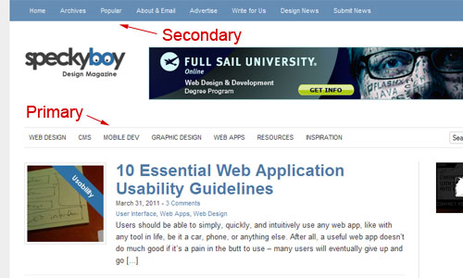
Navigation bar
Primary vs. Secondary
Primary: the menu of navigations that is most important to the user. (What they will use the most)
Secondary: the menu of navigations located at the top of the screen usually containing ‘about’ and ‘contact us’ etc.

Slide 13
Navigation Bar
Levels
One-Level: Need to be simple and straightforward. Can be difficult to include everything necessary in one small bar.
Drop-Down: These menus allow users to get to any page in the website in 1 click. It is important to make drop-down menus a reasonable size and type so it is easy for the user. Can add icons to make even simpler for the user.
Mega Drop-Down: While only being 2 levels deep, the menus usually have multiple columns. Can include context and hierarchy. Can begin to exceed the height of standard screen sizes (don’t want to scroll). Ex. Walmart. Avoid drop-downs with more than two levels.

Slide 14
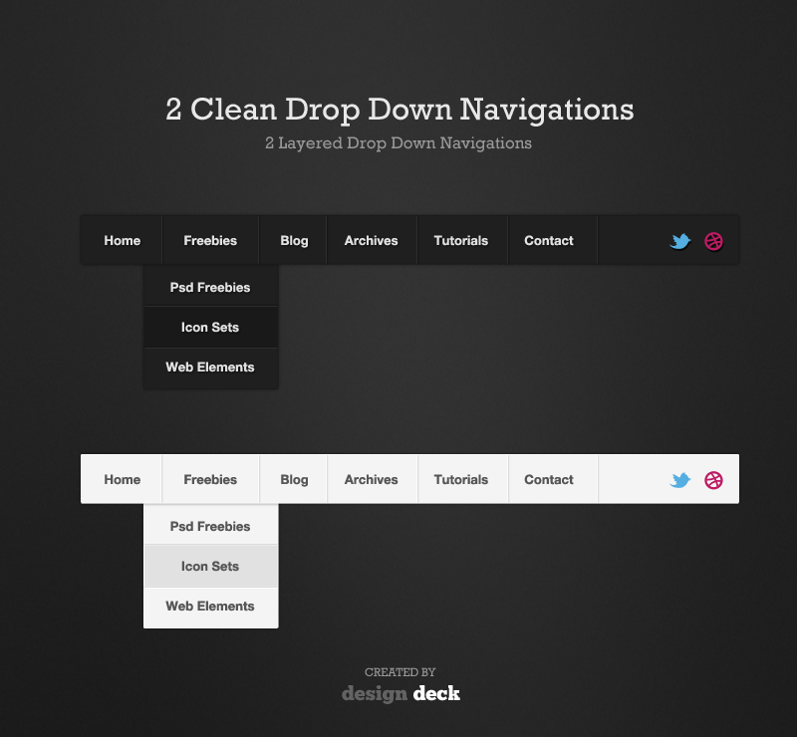
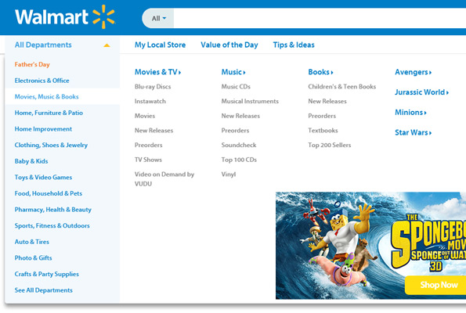

Slide 15
Navigation Bar
Hover vs Clickable
Hover: better for design and convenience. To make more user-friendly can add a delay closing feature on the bar
Clickable: more user-friendly.
Horizontal vs. Vertical
Horizontal: Main choice for navigation bars, especially for smaller websites
Vertical: used more by larger websites and usually used in combination with horizontal navigation bars

Slide 16
Navigation Bars
Style Tips
Remember to remove Tooltips from drop-down menu buttons
Menu should be consistent on all pages of the website
Consider using a semi-transparent background
Most important link should appear at the top and bottom of the list
Stick the menu to the page so the when the user scrolls the menu does not follow
Make the menu scalable to it can easily be changed if needed

Slide 17

Search Engine

Slide 18
What is Search Engine?
•Search Engine is a program that searches for and identifies items in a database that correspond to keywords or characters specified by the user, used especially for finding particular sites on the World Wide Web.
•Commonly known Types of Search Engine : GOOGLE , YAHOO, BING, ASK.COM

Slide 19
Search Engine on a Website
•Search engines on a website provide a convenient way for people to locate things on a site using the terms/keywords which they are familiar with.
•Three techniques in putting a search engine on a website:
1. Using a Free or Commercial Third Party Hosted Search Engine Service
2.Using the Major Search Engines
3.Installing our Own Search Engine Script

Slide 20
Free/Commercial Third Party Hosted Search Engine Service
These services index your site for you and provide you with the HTML code to plug into your web pages.
Advantage
1.You don’t have to run Perl or PHP scripts on your web server.
2.You don't have to worry about figuring out how to configure and upload Perl CGI scripts or PHP scripts.
Disadvantage
1.Most free services impose banner advertising on the results page.
2.If the search engine host decides to discontinue the service, than your site search will fail to work.

Slide 21
Using the Major Search Engines
Major search engines like Google as your site's search engine, are free of charge. To do this with Google, you go to Google Custom Search Engine and complete the online form.
Advantage
Easy to implement
Disadvantage
1.The results page has the search engine's advertisements and formatting.
2.You have even less control over the output than when using the third party search engine remotely hosted services.

Slide 22
Installing our Own Search Engine Script
•There are numerous free search engine scripts that you can adapt for your website.
Basically: install and run PHP or Perl scripts on your web account. No need to write one from scratch!
Disadvantage
1.You will need to play around with the Perl or PHP script in order to configure it. Search engine scripts typically need more configuration work .
2.You will need Perl or PHP support on your web server.
Advantage
1.One can customize their results page anyway they want.
2.There are no third party advertisements, except those you place yourself and those from your web host.

Slide 23
Design Layout
The most important thing to us when discussing the design was the layout so we started with it first
When looking at various user interfaces in applications, operating systems, and web pages, the good layouts and easy to use ones often were very simplistic so that’s what we aimed for in our design

Slide 24
Layout (Cont.)
Simplistic layouts consisted of good spacing between elements, not over cluttered, or too much information in one section
They also kept the design of elements within the layout simplistic and consistent, which helps the user better understand the user interface
Things like buttons that perform similar functions were the same size and color, font, and style
Fonts were kept as san-serif for readability, which are easier to read on devices with lower resolutions

Slide 25
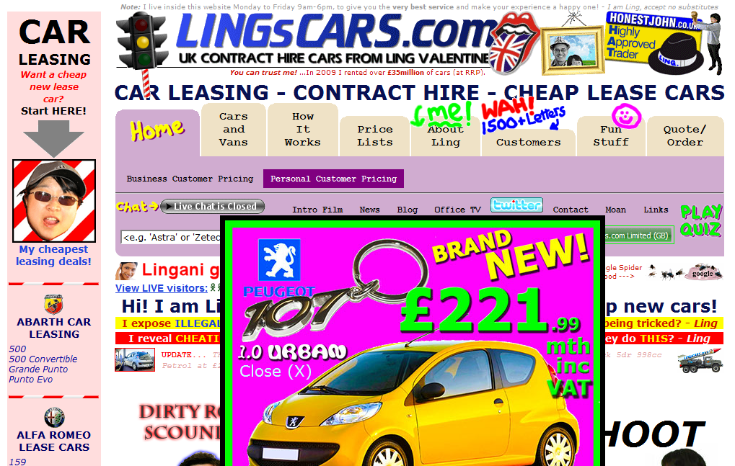
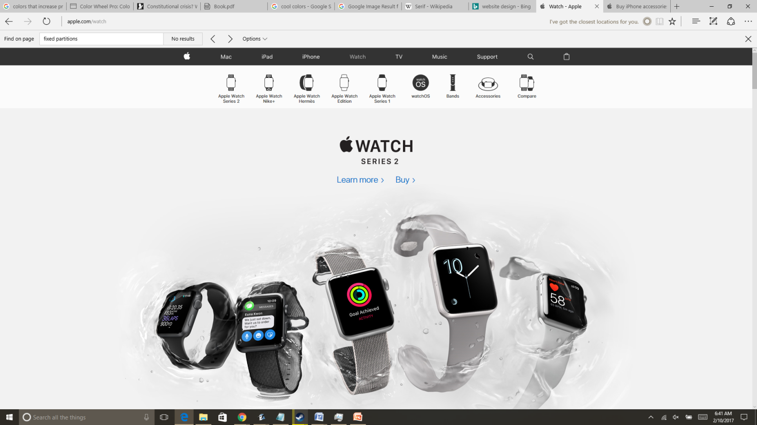
Bad Website Design
Modern Website Design

Slide 26

Colors
We want to keep our colors consistent and not have too many colors for the functional parts of our layout
Changing the color for common features is confusing and can be difficult for the user to understand no matter how good the layout is.
We choose cool colors for our website like blue and green which are the most common in our theme
The reason we choose cool colors is because they are believed to help with productivity, and they are also calming, and calm settings are often the best places to study.

Slide 27
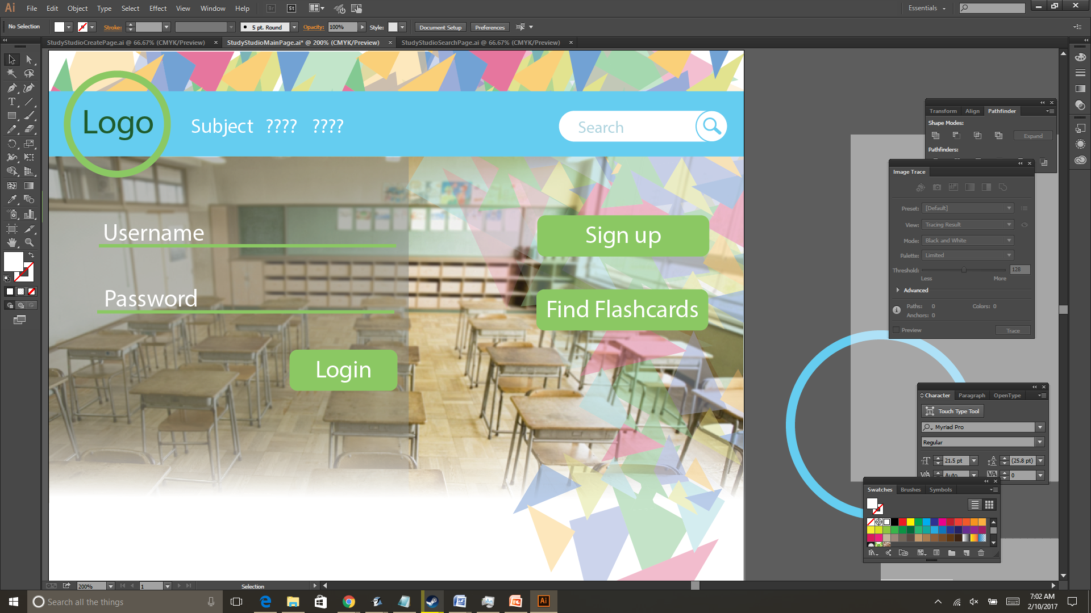
Current website design
We wanted to keep the colors consistent for the main functional features such as the buttons
The text is Arial which is a san-serif font, which is currently white, but can be different shades depending on our layout
This specific background is just for the sign in page, and overlaid on top of it is a design that helps our website look original and creative

